Slide 1
Wells Fargo - Data and Trend analysis
Sudipta Sarma

Slide 2
About Wells Fargo
San Francisco based international banking and financial services company
World’s second largest bank by market cap and the third largest bank in the US by assets
September 2016 - Scandal of unauthorized cross-selling and unsolicited fake accounts surfaced
Bank associates are entitled to commission pay of successful cross-selling or up-selling of any bank product or service
October 2016 - $185 million fine, losing ~$4 billion in revenue and breach of customer trust
More than 5000 employees fired and CEO John Stumpf stepped down
* Courtesy - https://en.wikipedia.org/wiki/Wells_Fargo, http://finance.yahoo.com/news/wells-fargo-fallout-study-says-145943938.html

Slide 3
About the project
Source - Financial products and services Consumer complaint database published by the consumer financial protection bureau (https://catalog.data.gov/dataset/consumer-complaint-database)
Database of consumer complaints dating from 2011 - Oct 2016 (Format - CSV file)
Focus on company - Wells Fargo in the wake of the recent scandal involving the creation of millions of fake consumer accounts created by thousands of the company employees
Analysis of complaint data in CA

Slide 4
Challenges with Raw data
No numeric data columns except “Complaint ID”
“Complaint ID” column not of much use - Needed complaint count instead
All data columns were of type “character” (string)
Had to resort to limited string “parsing” to prepare data for analysis
651,081 records as of 19th Oct 2016
Used functions - table(), strftime(),aggregate(),sort(),percent(),head(),grep()
Graphics functions - ggplot(),plot(),barplot(),pie()

Slide 5
Complaint data used for analysis…
"Date.received" "Product"
"Sub.product" "Issue"
"Sub.issue" “Consumer.complaint.narrative"
"Company.public.response" "Company"
"State" "ZIP.code"
"Tags" "Consumer.consent.provided."
"Submitted.via" "Date.sent.to.company"
“Company.response.to.consumer" "Timely.response."
"Consumer.disputed." "Complaint.ID"

Slide 6
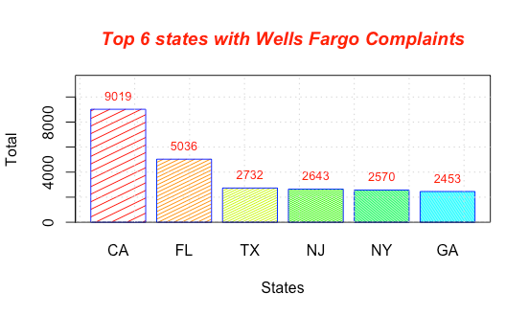
A Picture is worth a thousand words…

Slide 7
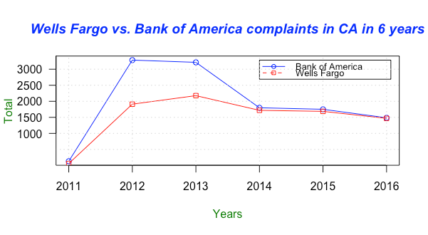
A Picture is worth a thousand words…

Slide 8
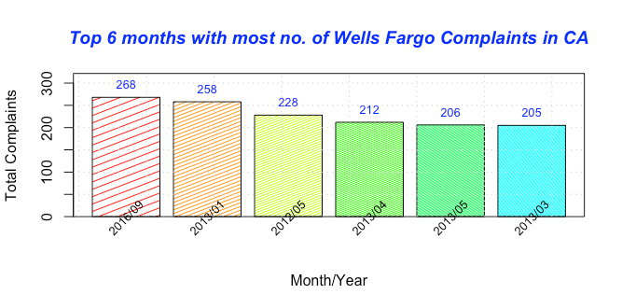
A Picture is worth a thousand words…

Slide 9
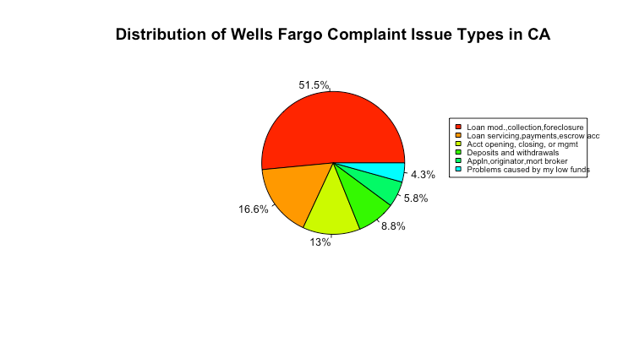
A Picture is worth a thousand words…

Slide 10
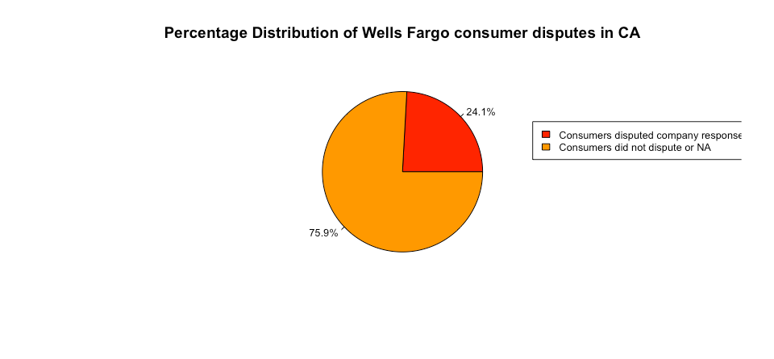
A Picture is worth a thousand words…

Slide 11
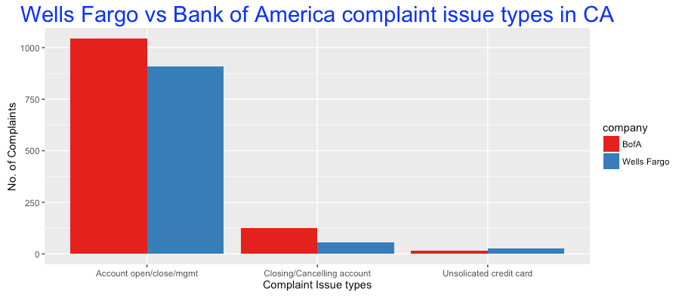
A Picture is worth a thousand words…

Slide 12
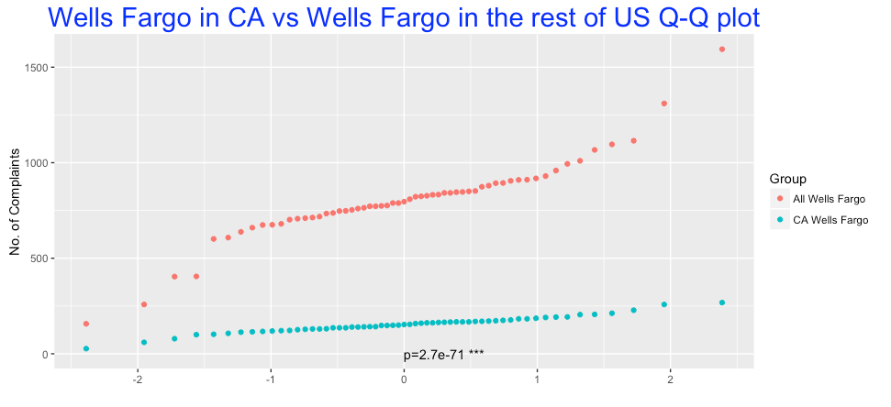
One-sample t-test

Slide 13
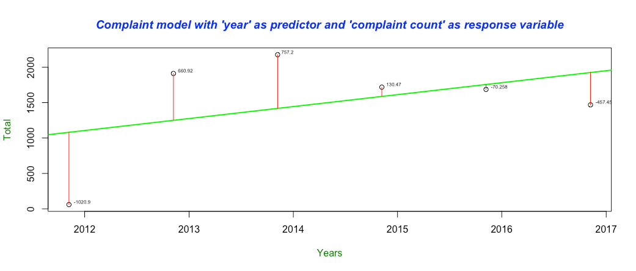
Linear Regression Model

Slide 14
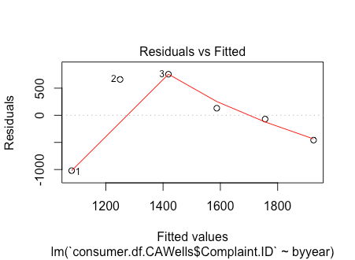
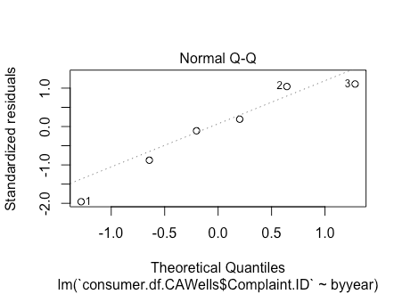
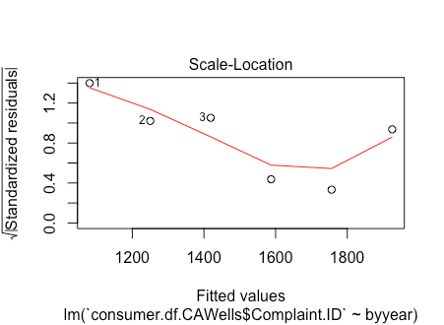
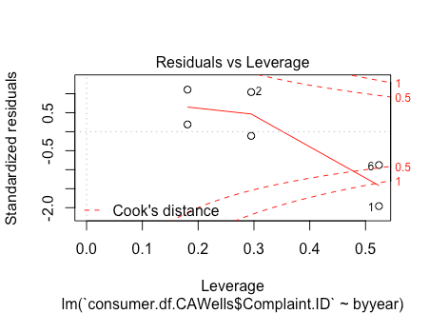
Linear Regression Model

Slide 15
Thank You!

